Slide 1


WORDS TO
EMOJY TRANSCRIPTER
GP Kaladhungi
Sakshi Rawat
Piyush Amola
Dakshita Pandey
Abhay Pratap Singh

Slide 2

OVERVIEW
01
02
03
Features
Technology Stack
Inplementation Steps
04
05
06
Challenges Faces
Resources Used
Future Scope

Slide 3
TECHNOLOGY STACK
01
02
03
React js
Redux
Python
06
07
08
Flask(Python)
My SQL
Socket.IO

Slide 4




ABOUT US
As a Student
As a Enthusiast
We are the student of GP Kaladhungi and we are here to represent our college and enhance our skills, confidence and to discover opportunities
We are the programming enthusiast who loves programming more than any other thing (except family, etc). We love to face challenges and trying out new things in life and wanted to discover it in the more depth.

Slide 5





FEATURES :-
These are the key Features we are focused while completing task
01
Not a single code and design is copied from any source (if you exclude the syntax of web-socket and some small other syntaxes)
02
Ease of Use, focuses on the ease of use rather than making user busy on authenticating itself though OTPs and other stuffs.
03
Custom Coloring options for the user, use change and use as he likes to look it like
04
Team work, every member is given a equal right to raise any objection.
05
Learning with creating, We learn from each other on how to perform these task in better and efficient way

Slide 6



RESOURCES USED(Server)
Flask (Python)
MY SQL
We used flask for the Purpose of proving server with login sign in APIs
Used mysql database for storing the data in tabular formate and access it according to the need of it

Slide 7



RESOURCES USED(user/ client)
React
Redux & Socket.io
Use react for single page Webapp with the fast rendering capability
Effective to provide chatting app a perfect Plateform.
Used to create dynamic feature and also to help on using async thunk
Socket io for the purpose of Websocket

Slide 8
RESOURCES USED (external)
Syntax of the Async Thunk of react Redux
Syntax of the SQL Alchemy in flask
Web Socket boiler Plate code for using it in React and Flask with example
Some SQL query like setting up database and table to handle unison code of 4 bytes.
Emoji Array for searching and replacing words manually rather than using other medias and AI APIS.
Open AI Integration code but discarded due to 429 error API problem.

Slide 9
RESOURCES USED (Old Programs)
Syntax of the Async Thunk
Store and React-Router-Dom configuration
Syntax of API creation in flask

Slide 10
CHALLENGES FACED
There are a lot of challenges that we all faced
Mid Term Examination
No WebSocket Experience
Late Problem and limitation Clearness
Time
Wasted time on finding OPENAI API’s (free) and Studing about websocket implmentation
Time Management
Problem analysis
Lack of knowledge of web socket

Slide 11

GOALS AND OBJECTIVES
Growth
Provides us to grow together in the environment where we lean thing from one another and get an opportunity to get to better network building
Self Satisfaction
It allows us to test over self in the harsh condition like this without using others codes and design and with the midterm and time boundation gives other level of satisfaction that we had at least created it in given time period!

Slide 12


TIMELINE
The Basic time line that we followed during hackethon

Slide 13

Day 1
After Afternoon(after midTerm) :
Disscussed on how we work and discusses the basic logics
Main UI design is created with the simple working of the server for some APIs
Day 1 :night
Setting up and testing web socket with the UI Designing and starting of the file and ppt creation
Day 2: Afternoon
Setting up web sockets chats and finding the way to implement It easily
Day 2 : evening
Setting up basic logic and adding custom color features with images and l
page
Day 3:night

Slide 14

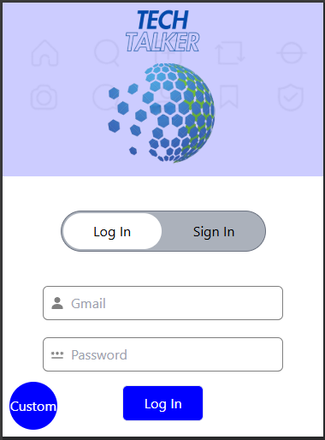
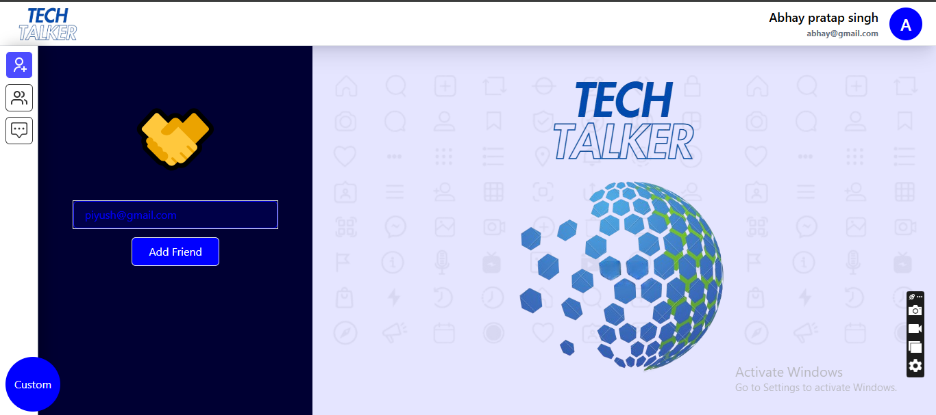

Slide 15
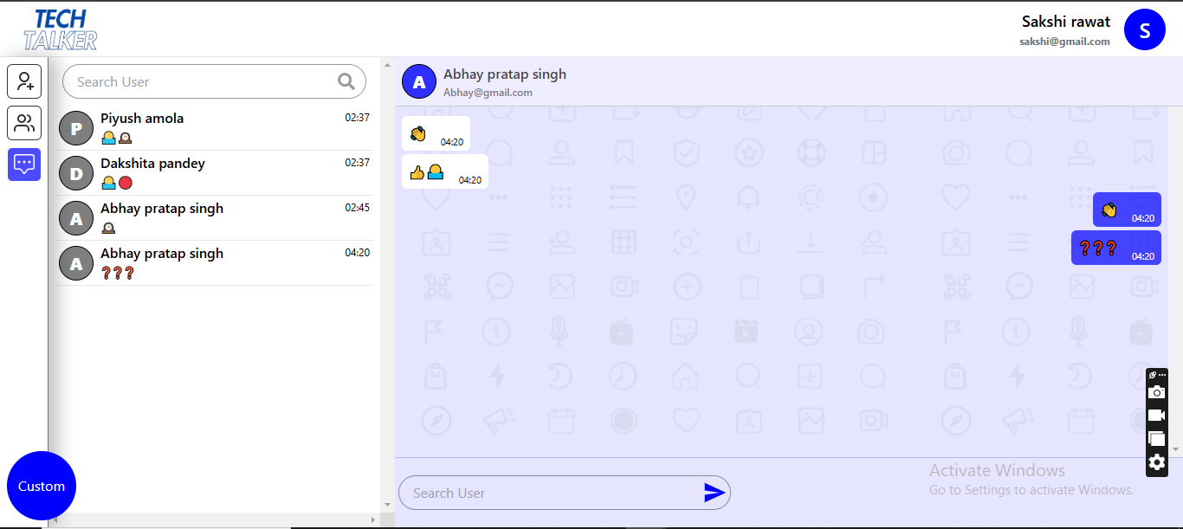
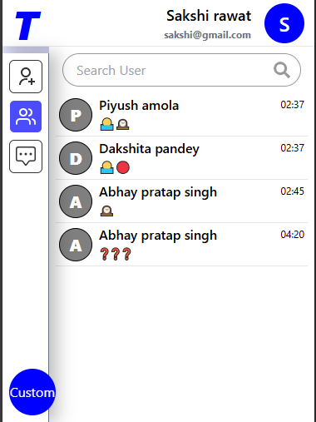
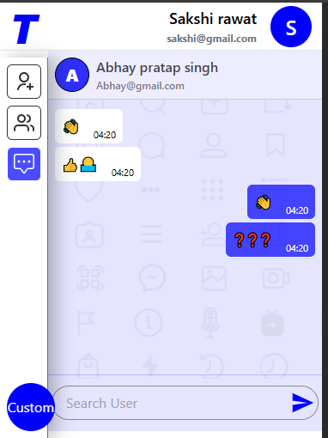
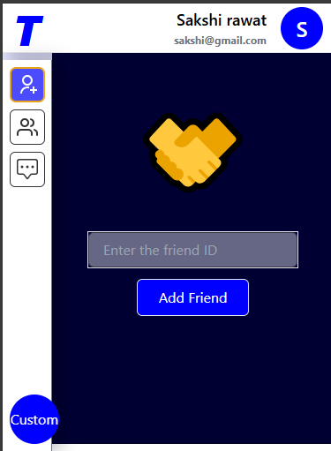
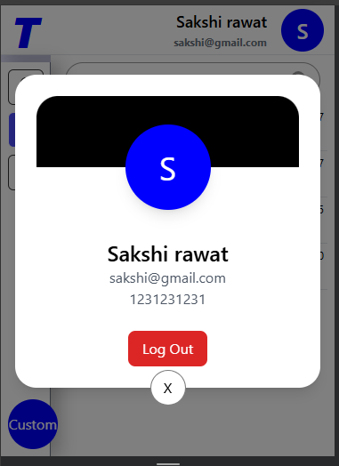
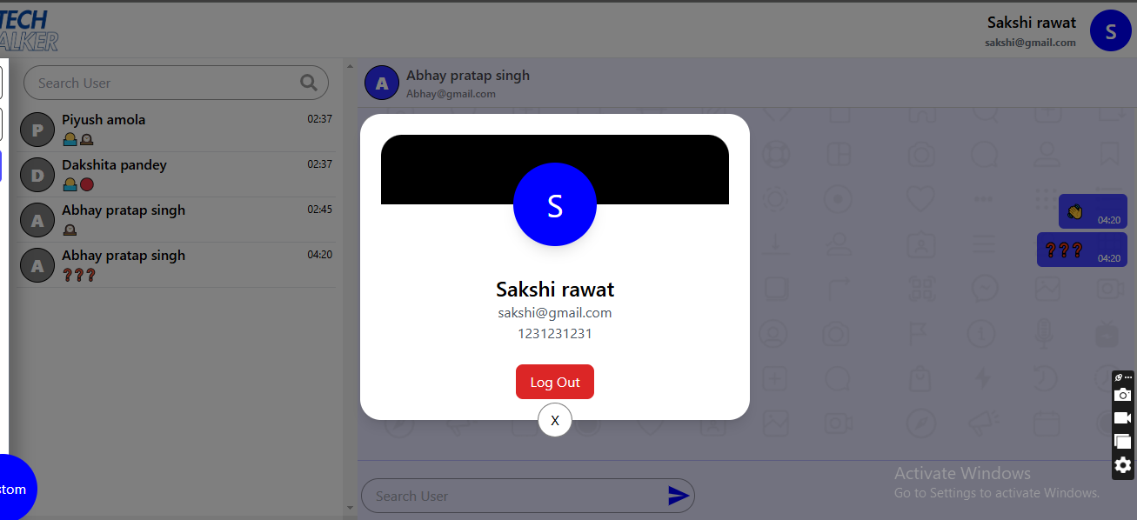

Slide 16
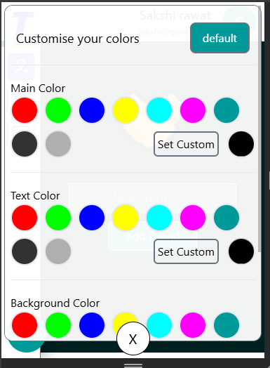
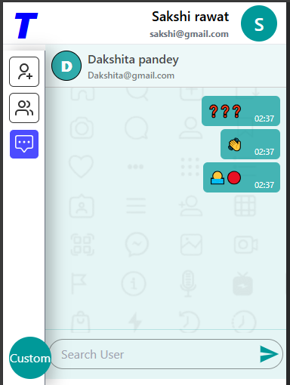
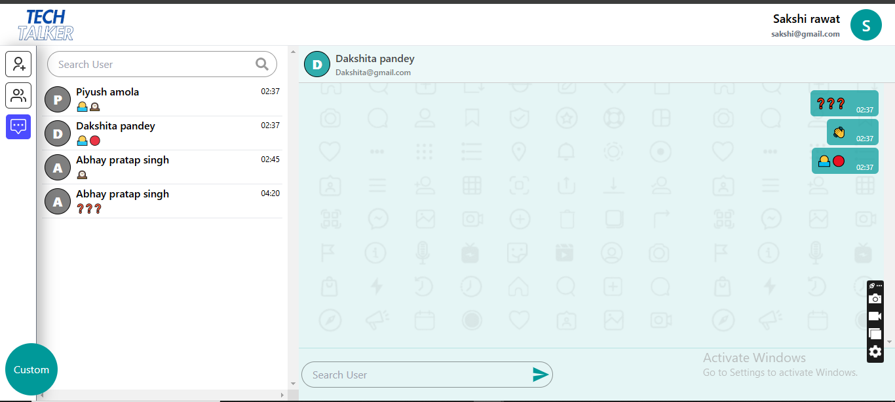
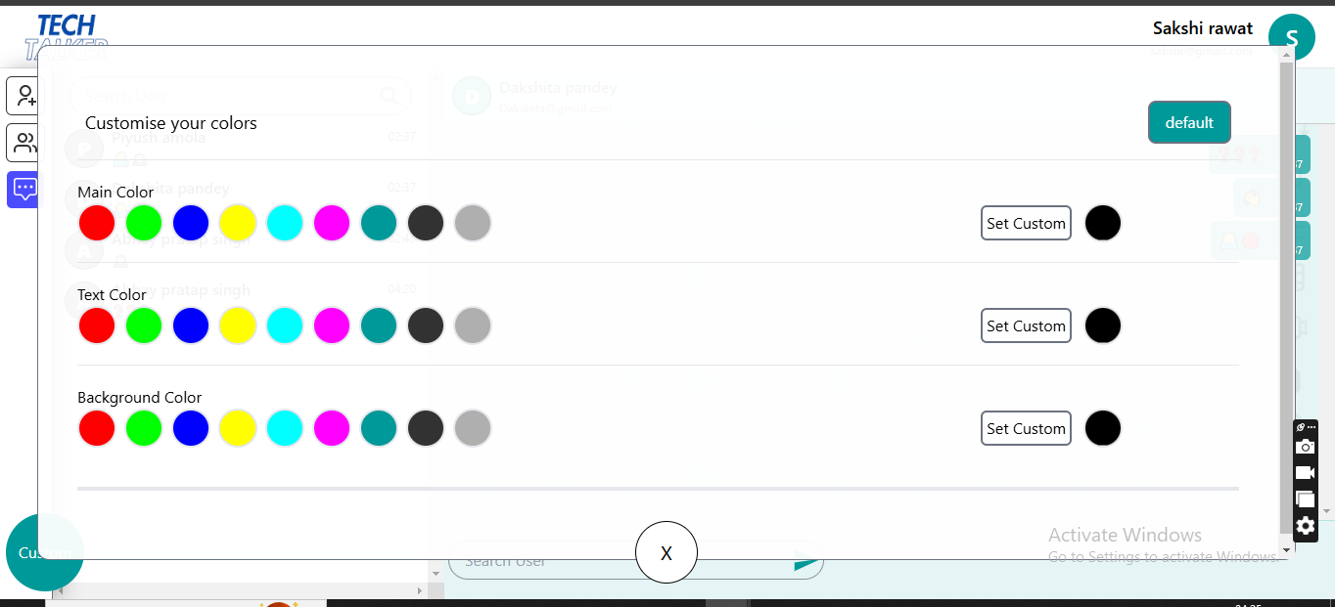

Slide 17






FUTURE SCOPE
New Opportunities
It has large no of opportunities as python at server can do a lot!(ML AI)
Helper Code
Program contain some codes that help in future development of it like a dynamic button and design which can be reused!
Innovation
New Ideas such as providing other dynamic like features to betterment of it

Slide 18

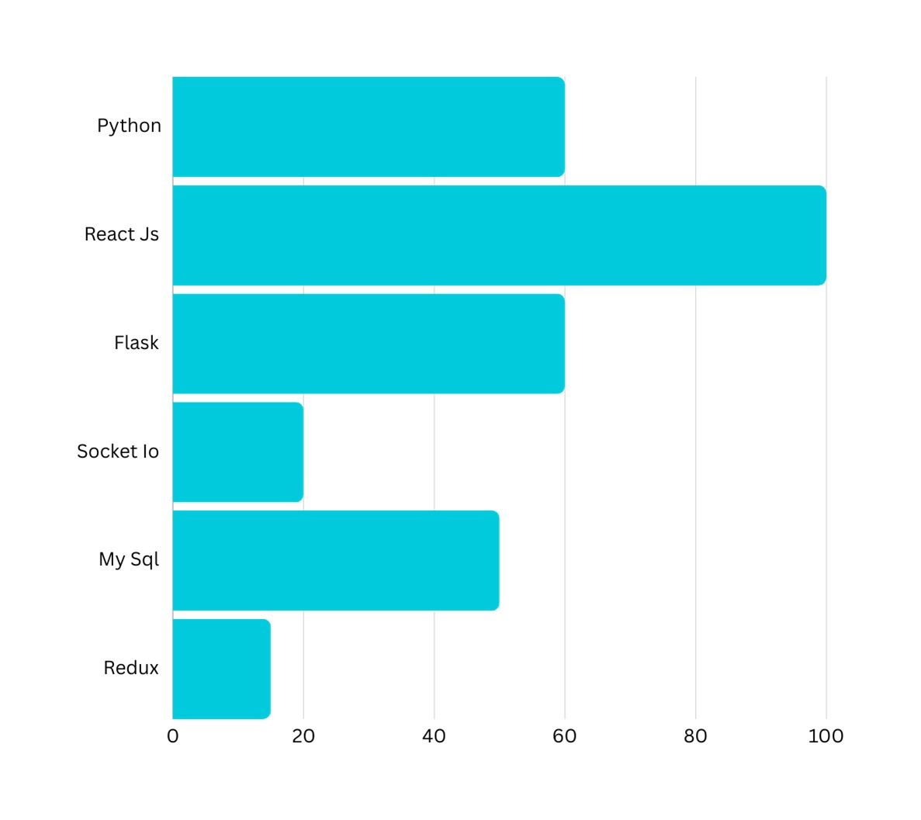
Laungage Uses
The Most Use language is the react js as all the code is done on it. Then flask and python with the socket io and mysql

Slide 19


OUR TEAM
A
S
D
P
Abhay Pratap Singh
Sakshi Rawat
Dakshita Pandey
Piyush Amola
Programer
Designer + program assistance
Designer + program assistance
Developer

Slide 20
WE ARE
NOT PERFECT
BUT
ONE DAY WE WILL!

